Slide 1
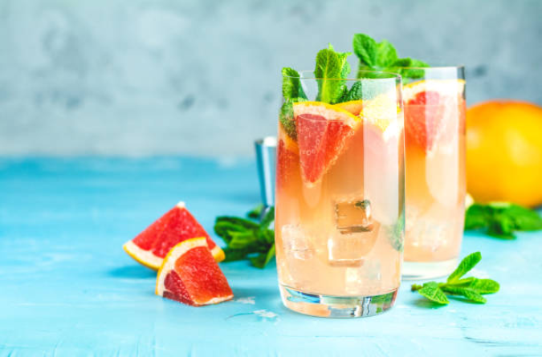
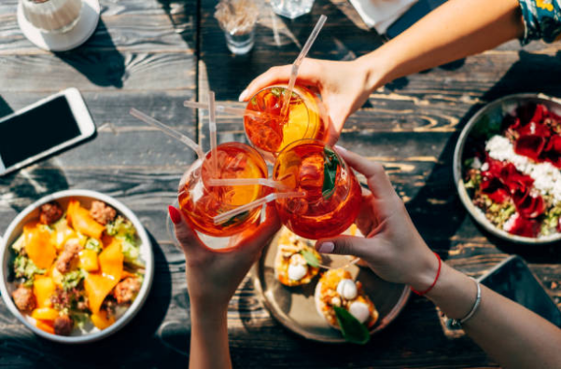
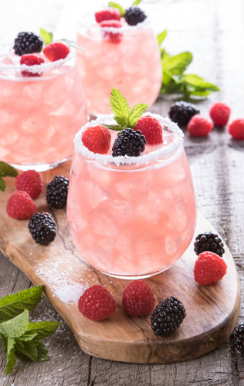
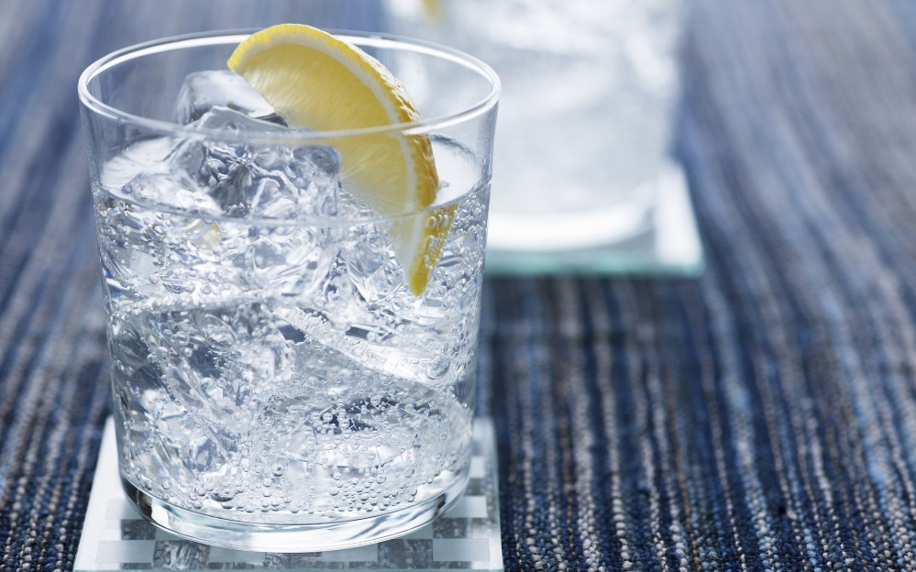
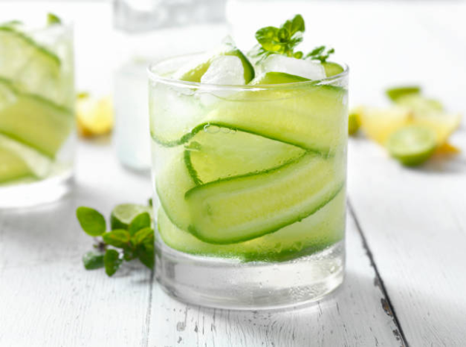
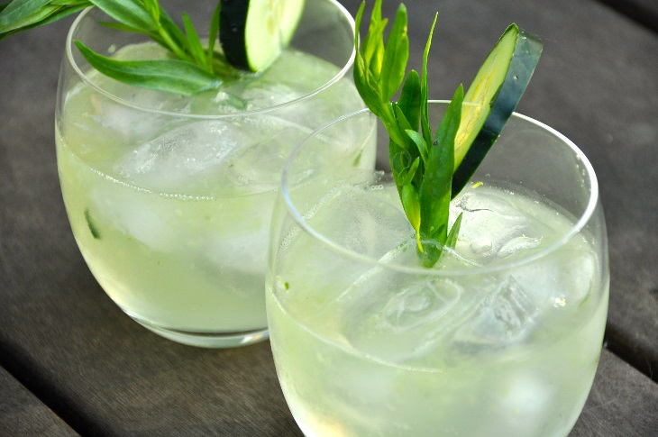
Spirits & Liqueurs
MARKET REVIEW
2020

Slide 2
CONTENTS
MARKET | Definition | p. 3
 | Market overview | p. 4-5
 | Top flavours | p.6
SPIRITS | Gin | p. 7-9
 | Vodka | p. 10-11
 | Rum | p. 12-13
 | Whisky | p. 14
LIQUEURS | Gin based | p. 15
 | Whisky based | p. 16
Regulation on Spirits & Liqueurs is specific and varies greatly depending on the country. We highly recommend you to check in details the regulation specific to your market regarding the use of flavours in these products.
www.expressions-aromatiques.com

Slide 3
DEFINITION
SPIRITS
The SPIRITS category (also called “Liquors”) designates a wide range of alcoholic beverages produced by DISTILLATION of fermented raw materials: grains, fruits or flowers.
The category includes : VODKA, GIN, WHISKY , RUM, TEQUILA and BRANDY with ABV* levels between 35% and up to 60%.
FRUITS, HERBS and PLANTS INFUSIONS are commonly used to flavour and give a twist to traditional recipes.
LIQUEURS
A LIQUEUR is a SWEET and FLAVOURED distilled spirit. Liqueurs are commonly flavoured with HERBS and SPICES, CREAM, FRUITS, FLOWERS or NUTS. In most cases, liqueurs are rather SWEET, SYRUPY and RARELY AGED. They usually have a much lower alcohol content, often between 15-30% ABV.
Today, with many of the traditional spirits such as vodka being flavoured, it has become rather difficult for many to distinguish between SPIRITS and LIQUEURS.
*Alcohol By Volume (%)
www.expressions-aromatiques.com
Notes:
spirits ABV % : http://www.alcoholcontents.com/liquor/
Liqueurs ABV % : https://www.gentlemansgazette.com/liqueur-guide/

Slide 4
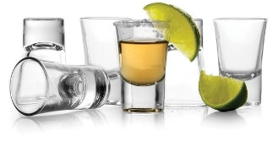
MARKET OVERVIEW
According to a “Statista” report, the worldwide SPIRITS & LIQUEURS MARKET is expected to grow annually by 3.2% over the forecast period 2019 – 2023. Revenue amounts to €392 bn in 2019 and should reach €445 bn in 2023 . The average PER CAPITA CONSUMPTION stands at 4.5 L in 2019.
LIQUEURS is the biggest subsegment of the spirits category (€187 bn in 2019), followed by WHISKY (€76 bn in 2019) in second position and BRANDY (€60 bn in 2019) in third position.
Consumption of liqueurs in ASIA-PACIFIC is expected to increase due to the growing young adult population and the growing consumption of high-quality liqueurs. However, EUROPE is predicted to be the fastest growing region.
Escalation of better-for-you drinks market, fueled by HEALTH CONCERNS should restrict the market growth in the future. Introduction of HEALTHIER VARIETIES of spirits and liqueurs is expected to offer LUCRATIVE OPPORTUNITIES for market players.
Sources : Statista – Spirits Worldwide 2019-2023
Allied Market Research - Global Opportunity Analysis and Industry Forecast, 2017-2023
www.expressions-aromatiques.com
Notes:
Statista – Spirits worldwide: https://www.statista.com/outlook/10020000/100/spirits/worldwide
Orbis Research – Global Spirits Market 2019-2024: https://www.reuters.com/brandfeatures/venture-capital/article?id=96229 (free sample: https://www.orbisresearch.com/contacts/request-sample/2899787)
Allied Market Research – Liqueurs Market Expected to Reach $131 Billion, Globally, by 2023: https://www.alliedmarketresearch.com/press-release/liqueurs-market.html

Slide 5
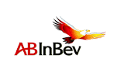
MARKET OVERVIEW
SOME OF THE LARGEST ALCOHOLIC BEVERAGES COMPANIES
Anheuser-Busch InBev
(Belgium)
Heineken Holding
(Netherlands)
Asahi Group Holdings
(Japan)
Kirin Holdings
(Japan)
Diageo
(United-Kingdom)
Suntory Holdings
(Japan)
Kweichow Moutai
(China)
Pernod Ricard
(France)
Molson Coors Brewing
(United-States)
Carlsberg
(Denmark)
Thai Beverage
(Thailand)
Constellation Brands
(United-States)
www.expressions-aromatiques.com
Notes:
http://www.worldstopexports.com/major-export-companies-alcoholic-beverages/

Slide 6
TOP FLAVOURS
TOP FLAVOURS
Innovative launches
2019-2020
Flowers
Elderflower
Hibiscus
Brown notes
Vanilla
Coffee
Herbs / Spices
Rose
Bergamot
Camomile
Lavender
Violet
Cherry blossom
Cornflower
Banana flambée
Peanut butter
Cookie / Cake
Caramel
Honey
Green tea
Rooibos
Ginger
Mint
Hemp
Nutmeg
Gingerbread
Chili pepper
Basil
Earl Grey
Cocoa / Chocolate
Vanilla + Cinnamon
Cinnamon
Spices
Plants / Herbs
Lemon
Ginger
Vanilla
Lime
Raspberry
Passion fruit
Orange
Strawberry
Pineapple
Grapefruit
Citrus
Coffee
Hemp
Peach
Source : ProtéinesXTC – Food Innovation Database

Slide 7
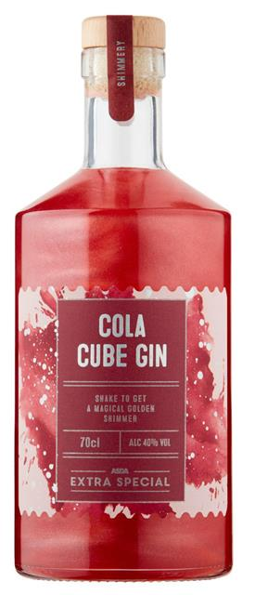
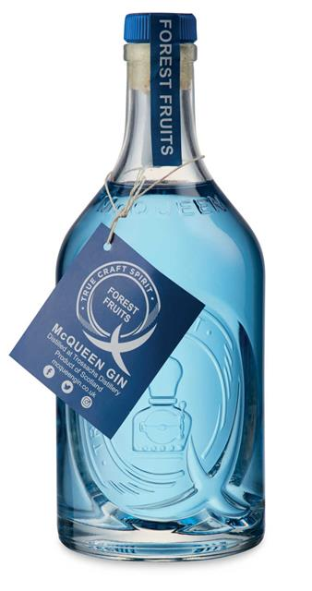
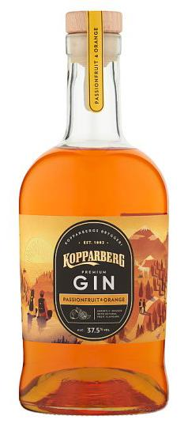
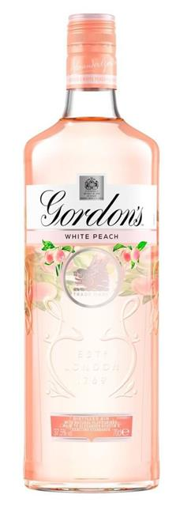
SPIRITS : GIN
GIN is a flavoured EAU DE VIE made by infusion or maceration of the spirit with spices, aromatic plants and herbs. The JUNIPER BERRY, from which gin takes its name, is an essential ingredient.
ASDA EXTRA SPECIAL
(United-Kingdom – 09/2020)
Gin with traditional candy flavour. Triple distillation. ABV = 40%
COLA CUBE
DALE MCQUEEN
(United-Kingdom – 05/2020)
Gin made with butterfly pea flower. When tonic water is added, colour changes (blue to pink). ABV = 37.5%
MIXED BERRIES
KOPPARBERG
(United-Kingdom – 05/2020)
Fruits flavoured gin.
ABV = 37.5%
ORANGE & PASSION FRUIT
GORDON'S
(United-Kingdom – 03/2020)
Diageo UK ltd.
Fruit flavoured gin. ABV = 37.5%
WHITE PEACH
*Alcohol By Volume (%)
www.expressions-aromatiques.com
Source : ProtéinesXTC – Food Innovation Database

Slide 8
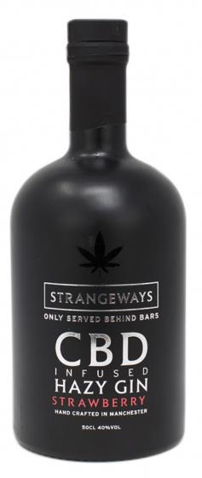
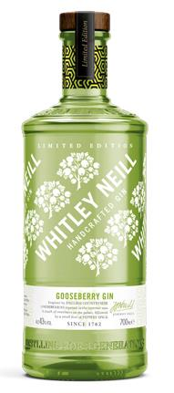
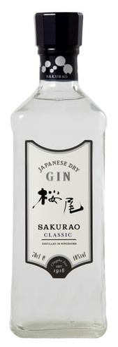
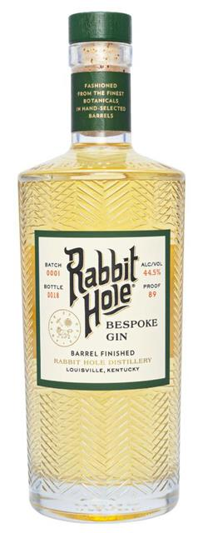
SPIRITS : GIN
SOPHISTICATED FLAVOURS
STRANGEWAYS
(France – 09/2020)
Handcrafted gin infused with cannabidiol (CBD). Handcrafted in Manchester. ABV = 40%
CITRUS & STRAWBERRY
WHITLEY NEILL
(United-Kingdom – 02/2020)
Handcrafted flavoured gin. Limited edition. ABV = 43%
GOOSEBERRY
SAKURAO
(Japan – 06/2020)
Japanese gin made from plants grown in Hiroshima. ABV = 40%
CITRUS, GREEN TEA & GINGER
RABBIT HOLE
(United-States – 05/2020)
Craft gin finished in rye whisky barrels. ABV = 44.5%
CITRUS, HONEYSUCKLE &
ELDERFLOWER
www.expressions-aromatiques.com
Source : ProtéinesXTC – Food Innovation Database
Notes:
Sakurao → Composed of lime, navel orange, bitter orange, sweet summer orange, cypress bark, green tea, red perilla and ginger.

Slide 9
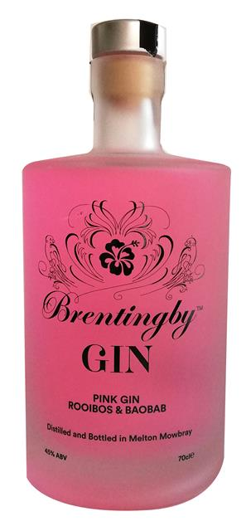
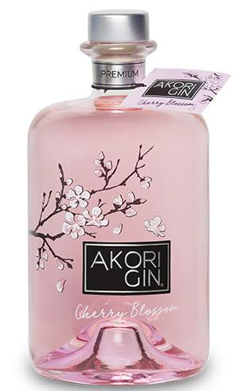
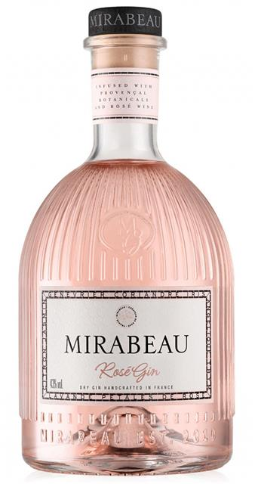
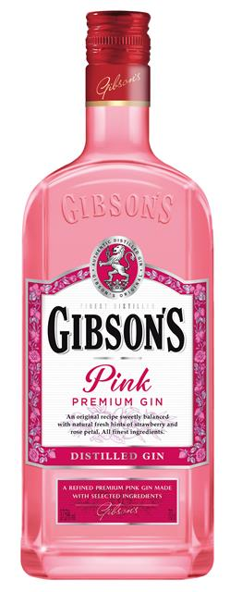
SPIRITS : GIN
PINK GIN
AKORI GIN
(Spain – 09/2019)
Japanese-inspired gin in a refined bottle. ABV = 40%
CHERRY BLOSSOM
MIRABEAU
(France – 01/2020)
Pink gin infused with Provençal botanicals and rosé wine.
ABV = 43%
ROSÉ WINE
GIBSON'S
(France – 07/2020) – La Martiniquaise
Pink gin with natural notes of strawberries and rose petals.
ABV = 37.5%
STRAWBERRY
BRENTINGBY GIN
(United-Kingdom – 05/2020)
Handcrafted gin distilled in small batches. ABV = 45%
ROOIBOS & BAOBAB
www.expressions-aromatiques.com
Source : ProtéinesXTC – Food Innovation Database
Notes:
Mirabeau → Provençal botanicals: juniper, coriander, iris, angelica, thyme, rose petals, lavender, lemon and jasmine.

Slide 10
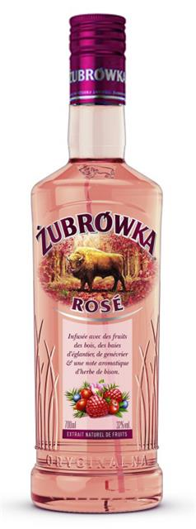
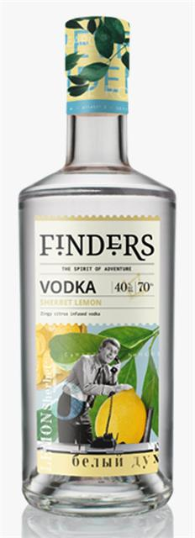
SPIRITS : VODKA
VODKA is a particularly good flavour carrier. Recent trends include PREMIUM FLAVOURS with intense, bold and well-rounded profile. Consumers are also looking for more NATURAL FORMULAS with juices and extracts.
BELVEDERE
(France – 10/2020) – LVMH
Polish vodka infused with fruits and Spices. ABV = 40%
GINGER, LEMON & GRAPEFRUIT
PRAIRIE SUSTAINABLE SEASONS
(United-States – 09/2020)
Vodka infused with fruits sustainably harvested. ABV = 30%
WATERMELON, CUCUMBER &
LIME
ZUBROWKA
(France – 04/2020)
Vodka infused with wild berries, rosehip berries and juniper berries with bison grass. ABV = 32%
WILD BERRIES
FINDERS
(United-Kingdom – 03/2020)
Vodka with natural ingredients and a fun label. ABV = 40%
SHERBET LEMON
www.expressions-aromatiques.com
Source : ProtéinesXTC – Food Innovation Database

Slide 11
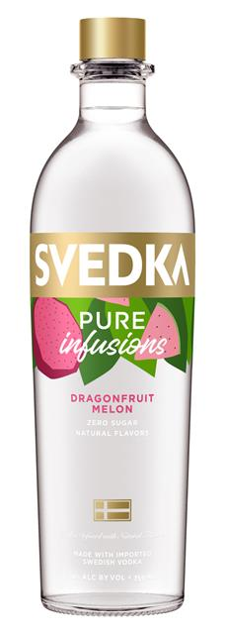
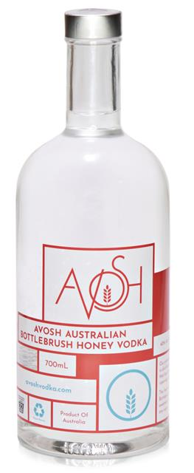
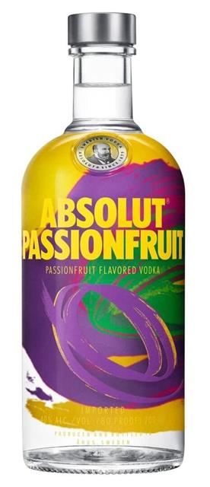
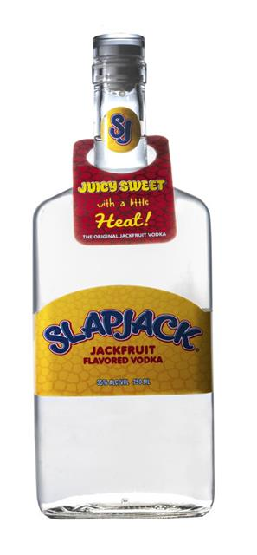
SPIRITS : VODKA
EXOTIC FLAVOURS
SVEDKA PURE INFUSIONS
(Sweden – 08/2020)
Swedish vodka infused with exotic fruits. Sugar free. ABV = 30%
DRAGONFRUIT & MELON
AVOSH
(Australia – 04/2020)
Vodka distilled with bottlebrush honey. ABV = 37.5%
HONEY
ABSOLUT VODKA
(United-Kingdom – 03/2020) – Pernod Ricard
Sugar free Swedish vodka with fruits. ABV = 40%
PASSION FRUIT
SLAPJACK
(United-States – 01/2020)
Vodka with fruity and spicy notes. Free from artificial colours and flavours. ABV = 35%
JACKFRUIT
www.expressions-aromatiques.com
Source : ProtéinesXTC – Food Innovation Database
Notes:
Avosh → pepper, anise and lemon zest.

Slide 12
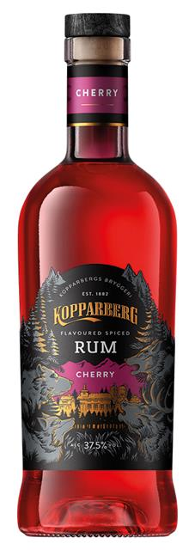
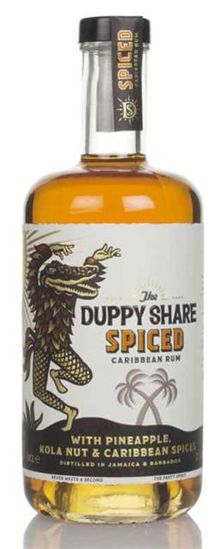
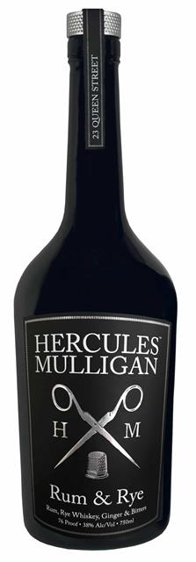
SPIRITS : RUM
RUM is a sugarcane spirit produced in a variety of ways and in many different countries and regions. WHITE RUM combines well with CITRUS and BERRY flavours, while AMBER RUM tend to combine well with BROWN NOTES, EXOTIC FRUITS and SPICY flavours.
BACARDI MARTINI FRANCE
(France – 10/2020)
Rum infused with vanilla, cinnamon, honey and nutmeg. ABV = 35%
SPICES
KOPPARBERG
(United-Kingdom – 08/2020)
Flavoured rum with spices.
ABV = 37.5%
CHERRY
THE DUPPY SHARE
(United-Kingdom – 05/2020)
Blend of Jamaica and Barbados rum with pineapple, kola nut and Caribbean spices. ABV = 37.5%
PINEAPPLE & KOLA NUT
HERCULES MULLIGAN
(United-States – 02/2020)
Blend of rum, rye whisky, bitter and ginger in a sophisticated bottle. ABV = 43%
WHISKY & GINGER
www.expressions-aromatiques.com
Source : ProtéinesXTC – Food Innovation Database

Slide 13
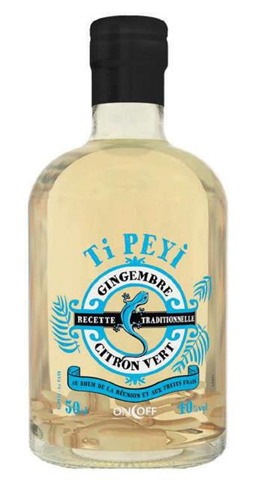
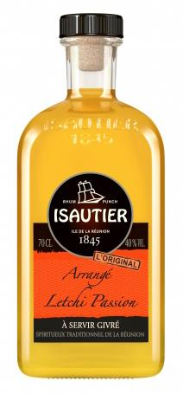
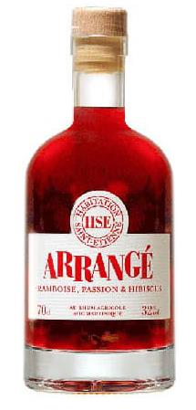
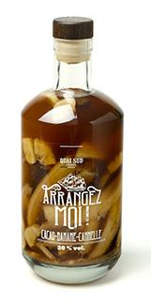
SPIRITS : RUM
RHUM ARRANGÉ
ON OFF TI PEYI
(France – 07/2020) - Intermarché
Rum from Réunion with macerated fresh ingredients. ABV = 30%
GINGER & LIME
ISAUTIER
(France – 07/2020)
Rhum arrangé in a sophisticated bottle. ABV = 40%
LITCHI & PASSION FRUIT
HABITATION SAINT-ETIENNE
(France – 07/2020)
Rum from Martinique with macerated fresh fruits. ABV = 32%
RASPBERRY, PASSION & HIBISCUS
QUAI SUD ARRANGEZ MOI!
(France – 07/2020)
Rhum arrangé macerated with fresh fruits. ABV = 30%
COCOA, BANANA & CINNAMON
www.expressions-aromatiques.com
Source : ProtéinesXTC – Food Innovation Database

Slide 14
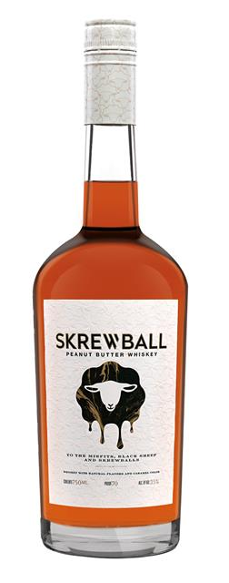
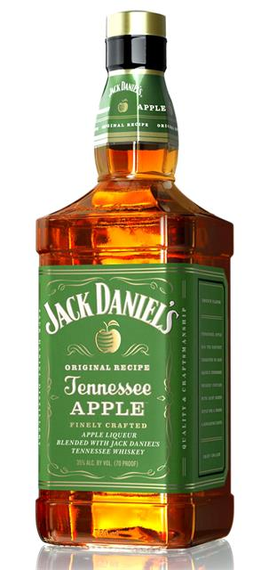
SPIRITS : WHISKY
WHISKY (or whiskey) is made by FERMENTING and DISTILLING GRAIN. Made all over the world, it is one of the most popular spirits. Whisky has a smoky taste that combines well with BROWN NOTES and SPICY flavours.
SKREWBALL
(USA – 02/2020)
Gourmet flavoured whisky. With natural flavours and caramel colour. ABV = 35%
PEANUT BUTTER
JAMESON COLD BREW
(Ireland – 02/2020)
Cold brew coffee flavoured whisky distilled three times. Limited edition. ABV = 30%
COFFEE
WILLIAM LAWSON'S
(France – 06/2020)
Whisky aged in oak barrels of bourbon. ABV = 35%
VANILLA, NUTMEG & CINNAMON
JACK DANIEL'S
(United-States – 12/2019)
Apple liqueur blended with JACK DANIEL'S whiskey. ABV = 35%
APPLE
www.expressions-aromatiques.com
Source : ProtéinesXTC – Food Innovation Database

Slide 15
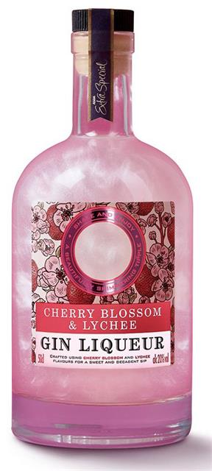
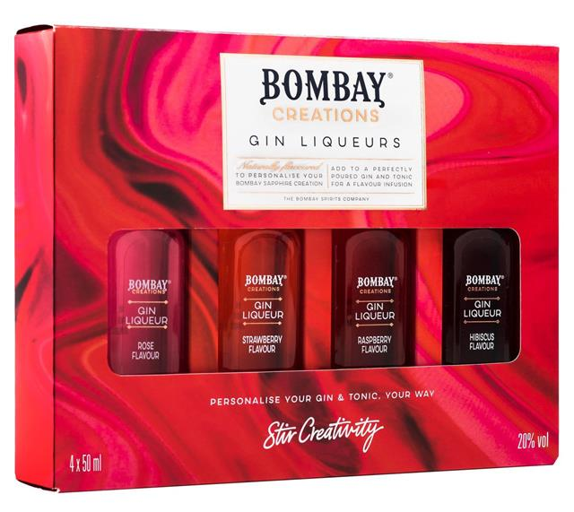
LIQUEURS : GIN BASED
While Gin is showing no sign of slowing down in the POPULARITY stakes, consumers are looking for INNOVATIVE and easy ways to UPGRADE their gin cocktails.
BOMBAY CREATIONS
(United-Kingdom – 02/2020)
Assortment of mini liqueurs in limited edition. ABV = 20%
ROSE, STRAWBERRY, RASPBERRY or HIBISCUS
ASDA STORES LIMITED
(United-Kingdom – 02/2020)
Pink gin liqueur with Japanese flavours. ABV = 20%
CHERRY BLOSSOM & LITCHI
ABER FALLS
(United-Kingdom – 03/2020)
Flavoured liqueur with Welsh-inspired ingredients. ABV = 20.3%
GINGERBREAD
THE INFUSIONIST
(United-Kingdom – 12/2019)
Gin liqueur with Christmas flavours. Distilled in small batches.
ABV = 20%
CANDY CANE
www.expressions-aromatiques.com
Source : ProtéinesXTC – Food Innovation Database

Slide 16
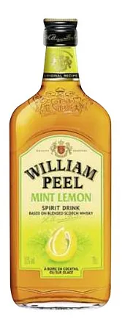
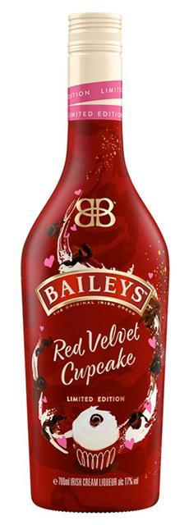
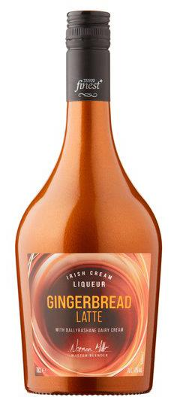
LIQUEURS : WHISKY BASED
While WHISKY liqueurs may be viewed as stagnant, in recent years the category has been revitalised. Typical flavours include CINNAMON, NUTMEG, HONEY and CARAMEL.
WHISKY CREAM LIQUEUR
THE DURIAN WHISKY
(Singapore – 11/2019)
Whisky liqueur with Musang King durian. ABV = 18%
DURIAN
WILLIAM PEEL
(France – 04/2020) – Marie Brizard
Whisky liqueur with citrus. Drink on ice or use in cocktails. ABV = 35%
MINT & LEMON
BAILEY’S LIMITED EDITION
(United-Kingdom – 02/2020)
Cupcake flavoured BAILEY'S in limited edition. ABV = 17%
RED VELVET CUPCAKE
TESCO FINEST
(United-Kingdom – 09/2020)
Liqueur made with Ballyrashane (Northern Ireland) dairy cream.
GINGERBREAD
www.expressions-aromatiques.com
Source : ProtéinesXTC – Food Innovation Database

