Slide 1
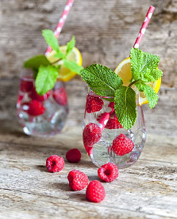
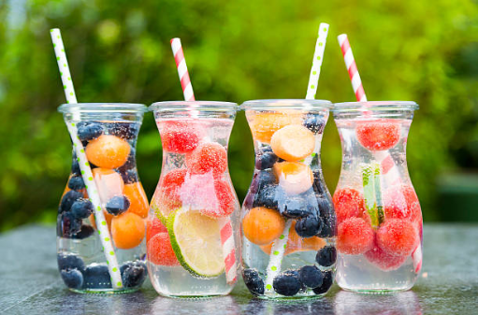
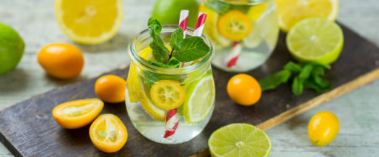
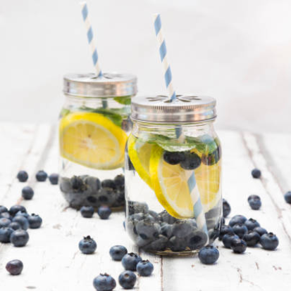
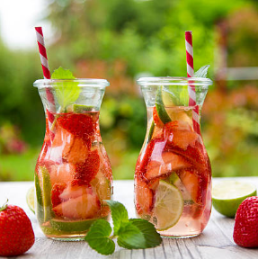
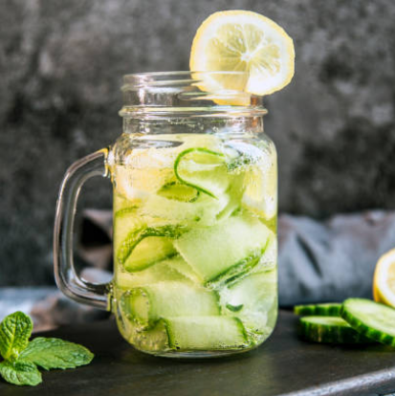
FLAVOURED WATERS
MARKET REVIEW
2020

Slide 2
CONTENTS
OVERVIEW | Top Trends / Claims | p. 03
 | Top flavours | p. 04
VARIETY OF SENSES | Citrus flavours | p. 05
 | Berry flavours | p. 06
 | Botanical flavours | p. 07
 | Floral notes | p. 08
 | Craving Cucumber | p. 09
 | Targeting Children | p. 10
FUNCTIONAL WATERS | Mood & Well-being | p. 11
 | Energy & Immunity | p. 12
 | Beauty from inside | p. 14
 | Hemp / CBD | p. 15
HYBRID BEVERAGES | Still fruit juice water | p. 17
 | Sparkling fruit juice water | p. 18
 | Tea infused water | p. 19
 | What’s next | p. 20
Regulation on Flavoured waters is specific and varies greatly depending on the country. We highly recommend you to check in details the regulation specific to your market regarding the use of flavours in these products.
www.expressions-aromatiques.com

Slide 3
TOP TRENDS / CLAIMS
TOP TRENDS / CLAIMS
With GROWING CONCERNS over obesity and diseases associated with obesity, the preference for LOW CALORIE DRINKS has risen considerably over the last few years.
1/ Health
Natural
Energy, Well-being
Slimness
Medical
As a result, consumers have migrated away from sugary juice and carbonated drinks looking for HEALTHIER ALTERNATIVES for themselves and their families.
2/ Pleasure
Variety of senses
Sophistication
ALL-NATURAL and WELL-BEING are the most sought after claims in the FLAVOURED WATERS & ENRICHED WATERS category.
3/ Ethics
Ecology
Solidarity
FUNCTIONAL INGREDIENTS such as vitamins, minerals but also cannabidiol and caffeine, add VALUE to the category.
4/ Convenience
Easy to handle
Nomadism
Source : XTC Innovations

Slide 4
TOP FLAVOURS
TOP FLAVOURS
Single-flavour or combined
(Innovative NPD 2019-2020)
As in many markets, artificial ingredients and additives are being targeted creating opportunities for NATURAL FLAVOURS.
Lemon
Apple
Lime
Peach
Raspberry
Tea (green, white, black…)
Orange
Strawberry
Cannabis/Hemp
Grapefruit
Ginger
Cucumber
Mint
Watermelon
Blackcurrant
Elderflower
Blackberry
Blueberry
Increasingly popular flavours include TEA and PLANT EXTRACTS, but also SPICES and FLORAL NOTES.
Soft drinks manufacturers take cue from the flavoured waters category, offering NEW HYBRID BEVERAGES made for example with spring or mineral water and fruit juice such as Oasis O’Verger (slide 17).
On the other hand, flavoured waters manufacturers use successful key elements from the soft drinks category to CREATE EXCITEMENT and NEW SENSORY EXPERIENCES. For example Contrex Green offers mineral water infused with organic mate (slide 19).
4
www.expressions-aromatiques.com
Source : XTC Innovations

Slide 5
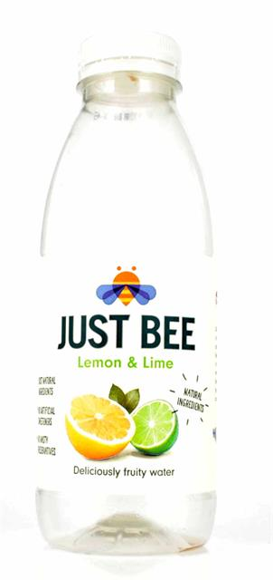
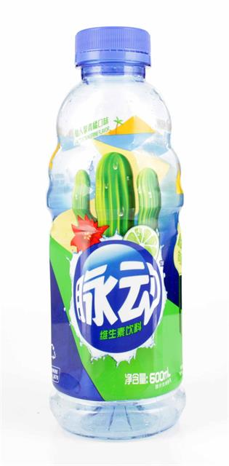
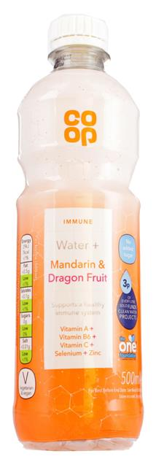
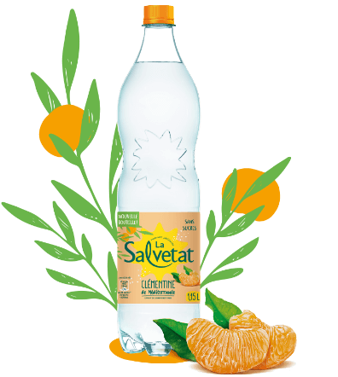
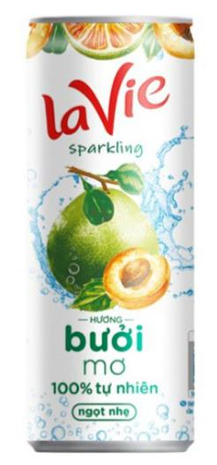
CITRUS FLAVOURS
Citrus are the most common fruits flavours. To appeal to more ADVENTUROUS CONSUMERS, they can be used in association with more UNUSUAL and EXOTIC FLAVOURS.
JUST BEE
United-Kingdom – 01/2019
Flavoured spring water with a hint of honey. In favour of bees. With natural flavours. Low calorie.
LEMON & LIME
COOP WATER +
United-Kingdom – 05/2019
Vitamin water with fruit in favour of The One Foundation charity supporting sustainable water. No added sugar.
MANDARIN & DRAGON FRUIT
LA VIE (Nestle Waters)
Vietnam – 01/2020
Sparkling carbonated water in a can. Sweetened with cane sugar and stevia.
POMELO & ABRICOT
MIZONE (Danone)
China – 01/2019
Fruit flavoured vitamin drink enriched with vitamins B6 and C.
CACTUS & TANGERINE
LA SALVETAT (Danone EAUX)
France – 06/2019
Sugar free sparkling water with natural fruit extracts.
CLEMENTINE from Italy
www.expressions-aromatiques.com
Source : XTC Innovations

Slide 6
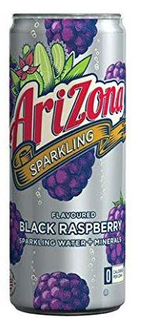
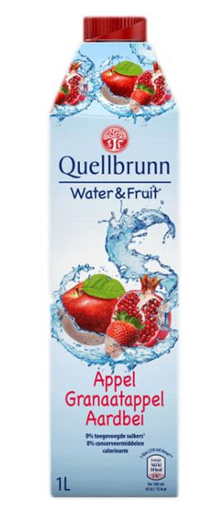
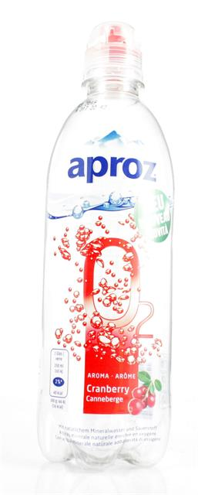
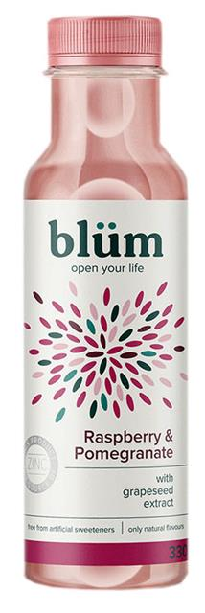
BERRY FLAVOURS
BERRIES are also very common flavours in the flavoured and enriched waters category. They offer a wide array of options in terms of FLAVOUR COMBINATIONS.
ARIZONA SPARKLING
Belgium – 02/2019
Flavoured enriched sparkling water, 100% natural. No calorie or sodium. No sweeteners. Natural flavours.
BLACK RASPBERRY
QUELLBRUNN (Aldi)
Netherlands – 02/2019
Low-calorie flavoured water. No preservatives. No added sugar.
APPLE, POMEGRANATE & STRAWBERRY
APROZ O2
Switzerland – 03/2019
Flavoured natural mineral water enriched with oxygen in a bottle with sports cap. Contains 30mg of oxygen. Low calorie. Natural flavour.
CRANBERRY
WAY2B
United-States – 12/2019
Flavoured water enriched with functional plant sterols. No added sugar. Natural flavours.
MIXED BERRIES
BLUM (Danone Waters)
United-Kingdom – 04/2019
Flavoured water enriched with zinc and grape seed extract.
RASPBERRY & POMEGRANATE
www.expressions-aromatiques.com
Source : XTC Innovations

Slide 7
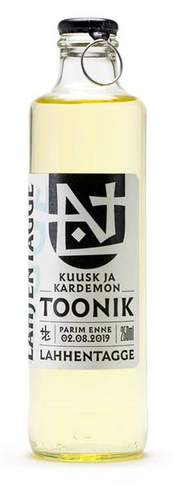
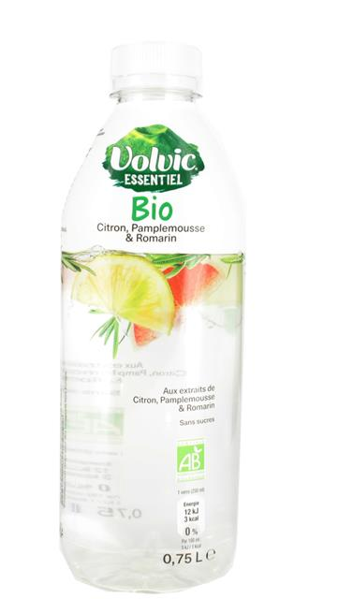
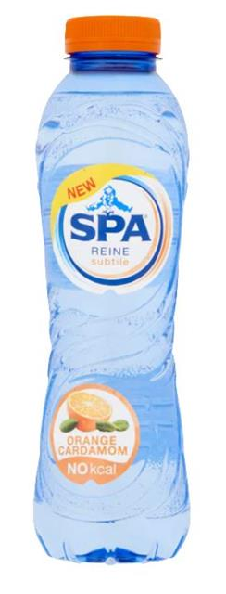
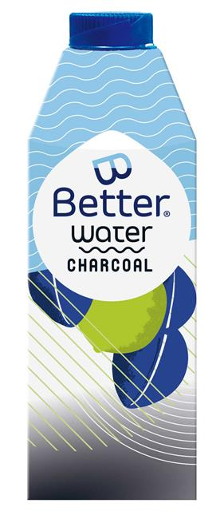
BOTANICAL FLAVOURS
There is a thirst for BOTANICAL FLAVOURS. According to Innova Market Insights, the fastest growing botanical flavours in global soft drink launches are HIBISCUS, BASIL and TURMERIC.
INFUZE
India – 02/2019
Flavoured water with no sugar or preservatives. 100% natural. Non-carbonated drink.
BASIL
LAHHENTAGGE
Estonia – 02/2019
Carbonated drink made from Christmas trees (spruces) collected from Estonian cities after Christmas holidays before they dry up.
CARDAMOM
B-BETTER WATER
Belgium – 09/2019
Flavoured water in 90% plant-based carton. 1% of the profit goes to local clean-up projects in Belgium.
CHARCOAL, LIME, MINT & GINGER
VOLVIC ESSENTIEL BIO
France – 05/2019
Organic drink with mineral water and plant extracts. Sugar-free.
LEMON, GRAPEFRUIT & ROSEMARY
SPA REINE SUBTILE
Belgium – 07/2019
Natural mineral water with natural flavours. No calorie.
ORANGE & CARDAMOM
www.expressions-aromatiques.com
Source : XTC Innovations
Notes:
Spruce → épicéa

Slide 8
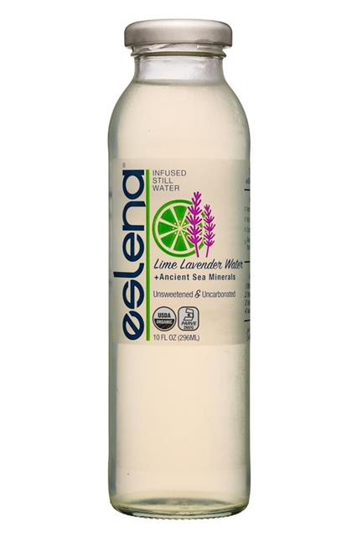
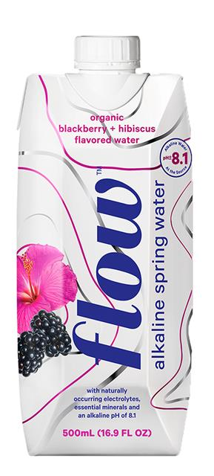
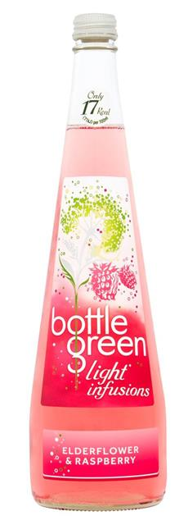
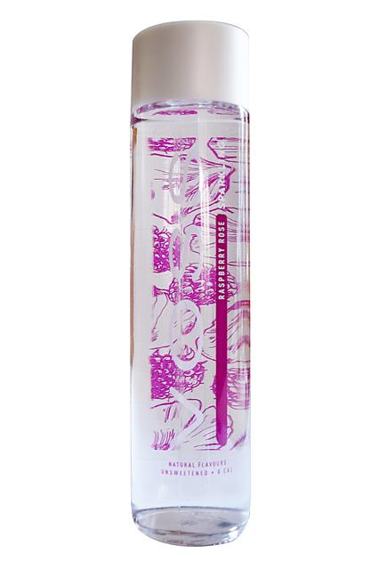
FLORAL NOTES
FLORAL NOTES are key to flavour innovation in beverages. The heighten the PREMIUM DIMENSION of flavoured waters and enriched waters.
ESLENA
United-States – 01/2019
Water infused with organic fruits and plants with a hint of sea salt. No sugar. In a glass bottle.
LIME & LAVENDER
FLOW WATER
Canada – 06/2019
Alkaline spring water with organic flavours. No added sugar. Made with a plant-based cap.
BLACKBERRY & HIBISCUS
BOTTLE GREEN LIGHT INFUSIONS
United-Kingdom – 12/2019
Low calorie elderflower infused drink. 17 calories per 100ml.
Natural flavours.
ELDERFLOWER & RASPBERRY
VOSS
Norway – 03/2020
Flavoured sparkling water made with artesian water from Norway.
Natural flavours.
RASPBERRY & ROSE
VOLVIC TOUCH OF FRUIT (Danone)
United-Kingdom – 03/2020
Refreshingly fruity volcanic water with a touch of natural raspberry flavour blended with cherry blossom notes. Limited edition.
RASPBERRY & CHERRY BLOSSOM
www.expressions-aromatiques.com
Source : XTC Innovations
Notes:
Alkaline water → Alkaline water has a higher pH level than regular drinking water (between 8 and 9 when normal water has a neutral pH of 7). Less acidic water, believe to neutralize the acid in human body.
Some say it can help to slow the aging process and prevent chronic diseases.
Artesian water → Artesian water is the confined natural underground reservoir that contains water under positive pressure. It has a rich concentration of natural minerals. It is also considered to be free from contaminants.

Slide 9
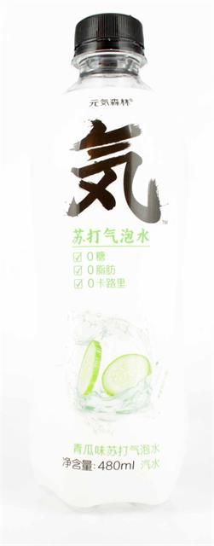
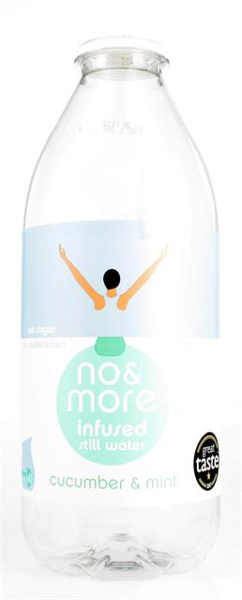
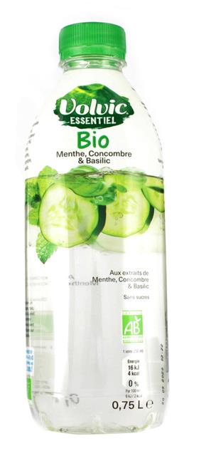
CRAVING CUCUMBER
Cucumber flavour in beverages is here to stay, as consumers’ mindsets are moving towards
LESS SWEET PROFILES.
NO&MORE
United-Kingdom – 03/2019
Sugar-free flavoured water to promote hydration. No sweeteners or preservatives. Natural flavours.
CUCUMBER & MINT
DASH WATER
United-Kingdom – 01/2020
Sparkling water infused with downgraded fruits or vegetables, no calorie, sugar or sweeteners. Made with British spring water. Natural flavours.
CUCUMBER
YUANQI FOREST
China – 01/2019
Flavoured sparkling water with no sugar, calorie or fat.
CUCUMBER
VOLVIC ESSENTIEL BIO
France – 05/2019
Organic drink with mineral water and plant extracts. Sugar-free.
MINT, CUCUMBER & BASIL
www.expressions-aromatiques.com
Source : XTC Innovations

Slide 10
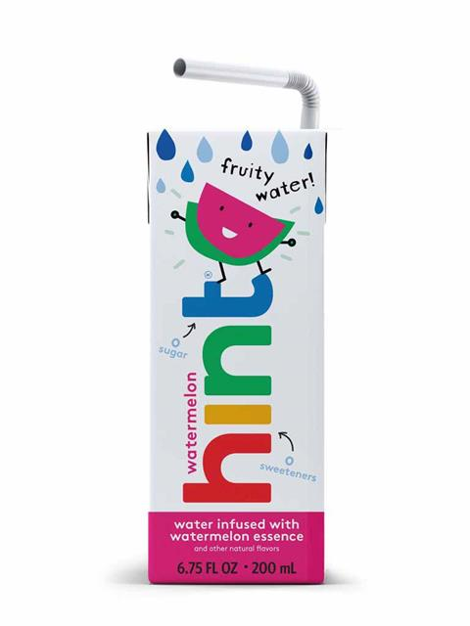
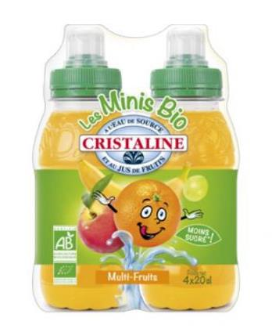
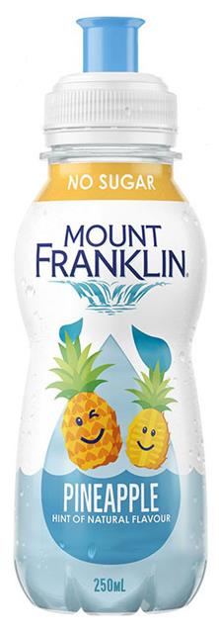
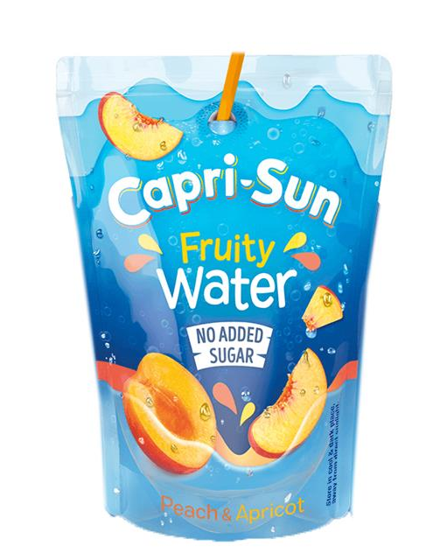
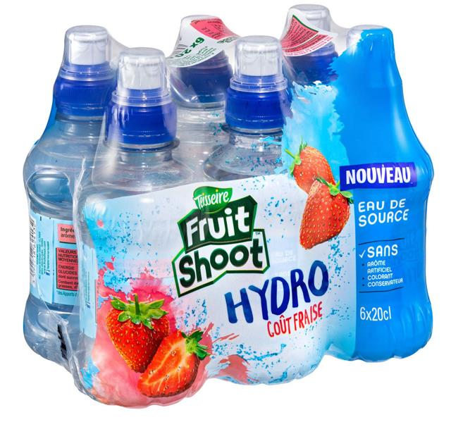
TARGETING CHILDREN
Manufacturers are increasingly offering HEALTHIER ALTERNATIVES to regular sweet beverages:
less sugar, natural flavours, fruit juice, easy-to-handle packaging...
HINT FRUIT WATER
United-States – 01/2019
Fruit infused water for children in a carton to go. Sugar and sweetener free. Natural flavours.
WATERMELON
CRISTALINE
France – 02/2019
Organic drink with spring water and fruit juice in a bottle with a sport cap for kids. Natural flavours.
MULTI-FRUITS
MOUNT FRANKLIN (Coca-Cola)
Australia – 02/2019
Sugar-free flavoured water for children in a bottle with a sport cap. Hint of natural flavour.
100% recyclable.
PINEAPPLE
FRUIT SHOOT HYDRO (Teisseire)
France – 05/2019
Spring water with natural fruit flavour in small bottles with sport caps. No artificial flavours, colours or preservatives.
STRAWBERRY
CAPRI-SUN (Coca-Cola)
United-Kingdom – 07/2019
Water with fruit juice in a transparent pouch. No added sugar, preservatives or colours. Natural flavours.
PEACH & APRICOT
www.expressions-aromatiques.com
Source : XTC Innovations

Slide 11
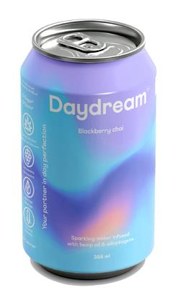
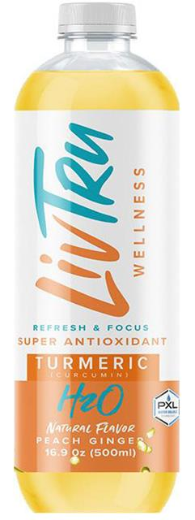
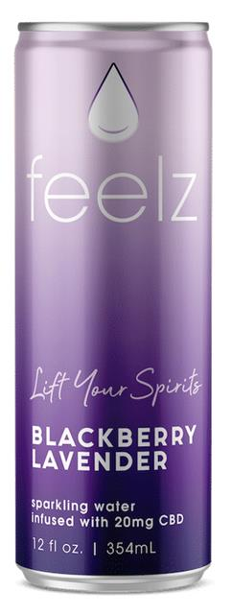
MOOD & WELL-BEING
As consumers become more aware of the connection between nutrition, physical health and MENTAL WELLBEING, there is strong demand for ingredients affecting MOOD.
DAYDREAM
Canada – 09/2019
Sparkling water infused with hemp and adaptogenic plants (schisandra, moringa and ginseng), with no added sugar. Adaptogenic plants help to fight stress. Natural flavours.
BLACKBERRY & CHAI SPICES
LIV TRU WELLNESS
United-States – 11/2019
Functional turmeric drink, rich in antioxidants. With kucha tea extract. Boosts immunity, detox, cognitive function and promotes mood balance and radiant skin. Natural flavours.
PEACH & GINGER
FEELZ
United-States – 12/2019
Flavoured sparkling water infused with cannabidiol for well-being. Contains caffeine and added vitamins.
Natural flavours.
BLACKBERRY & LAVENDER
SYSTEME U (Private label)
France – 01/2020
Spring water with apple and apricot juice and verbena extract, for serenity. Enriched with vitamin B6.
Natural flavours.
APPLE, APRICOT & VERBENA
www.expressions-aromatiques.com
Source : XTC Innovations

Slide 12
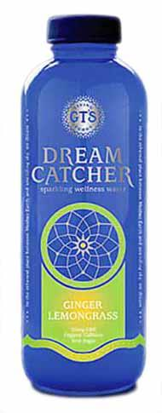
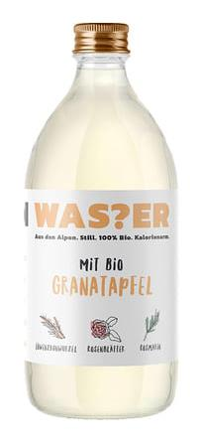
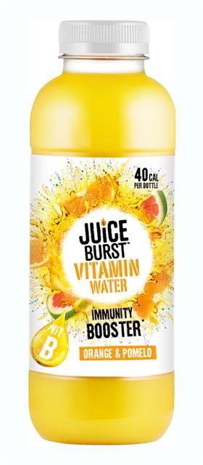
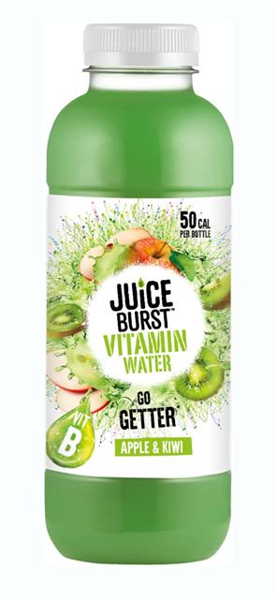
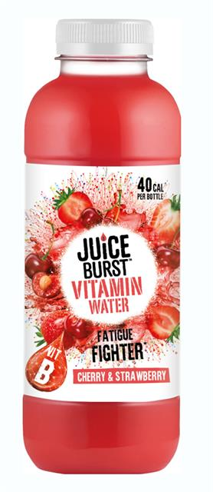
ENERGY & IMMUNITY
Enriched waters BOOSTING IMMUNITY and providing NATURAL ENERGY are also gaining momentum with trendy ingredients such as botanical extracts and green coffee.
GT’S LIVING FOODS
United-States – 01/2019
Sparkling water for well-being with added vitamins and natural caffeine. Contains raw apple cider vinegar to provide digestive support.
GINGER & LEMONGRASS
ICH BIN WAS?ER
Austria – 11/2019
Spring water with rosemary to boost concentration, rose leaves to support the immune system and dandelion root to strengthen liver health.
POMEGRANATE
JUICE BURST VITAMIN WATER
United-Kingdom – 12/2019
Vitamin water with fruits juice enriched with vitamins B. Less than 50 calories per serving. Natural flavours.
Immunity Booster – ORANGE & POMELO
Go-Getter – APPLE & KIWI
Fatigue fighter – CHERRY & STRAWBERRY
SYSTEME U (Private label)
France – 01/2020
Spring water with lemon and grapefruit juice and green coffee extract, for energy. Enriched with vitamin C. Natural flavours.
LEMON, GRAPEFRUIT & GREEN COFFEE
www.expressions-aromatiques.com
Source : XTC Innovations

Slide 13
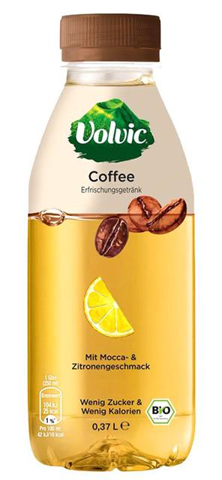
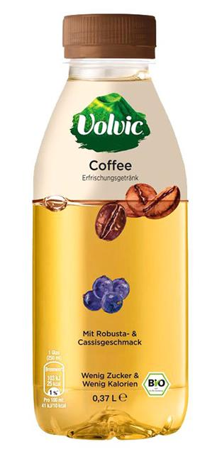
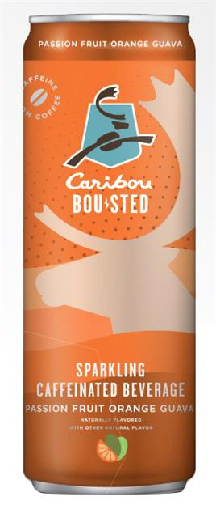
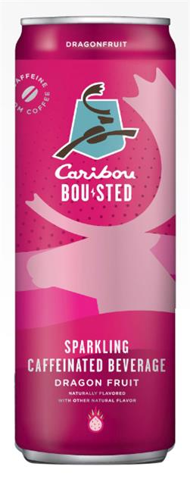
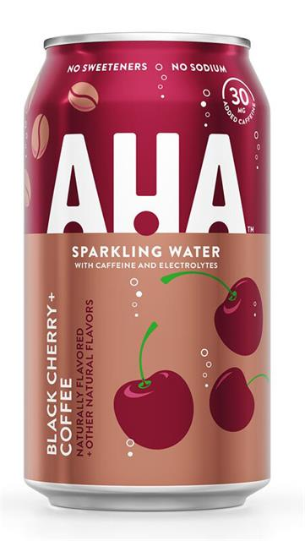
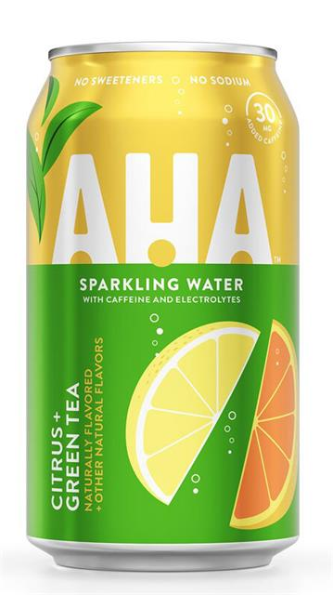
ENERGY & IMMUNITY
Drinking caffeinated water has become an increasingly popular way to stay HYDRATED while getting a BOOST OF ENERGY.
VOLVIC COFFEE (Danone)
Germany – 06/2019
Flavoured natural mineral water infused with coffee. Natural flavours.
ARABICA, PASSION FRUIT & LITCHI
ROBUSTA & BLACKCURRANT
MOCHA & LEMON
CARIBOU COFFEE CO.
United-States – 10/2019
Flavoured sparkling water enriched with caffeine, derived from coffee beans, ginseng and guarana extract. Natural flavours.
PASSION FRUIT, ORANGE & GUAVA
DRAGON FRUIT
AHA SPARKLING WATER (Coca-Cola)
United-States – 03/2020
Sparkling water enriched with caffeine and electrolytes. Sodium free. No sweeteners. No calorie. Contains 30mg of caffeine. Natural flavours.
BLACK CHERRY & COFFEE
CITRUS & GREEN TEA
www.expressions-aromatiques.com
Source : XTC Innovations

Slide 14
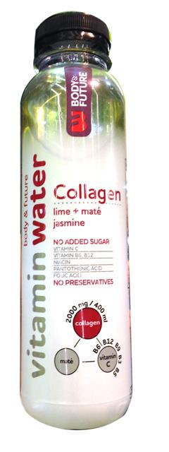
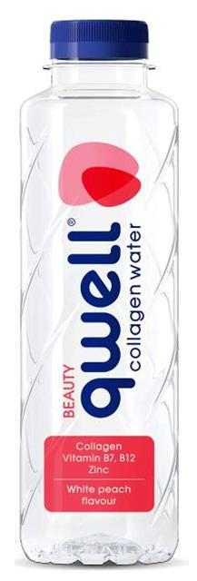
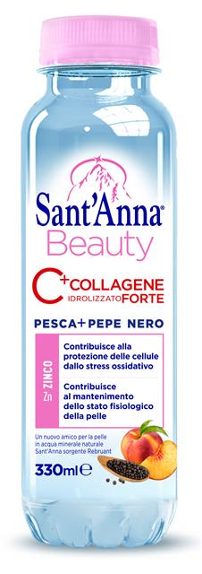
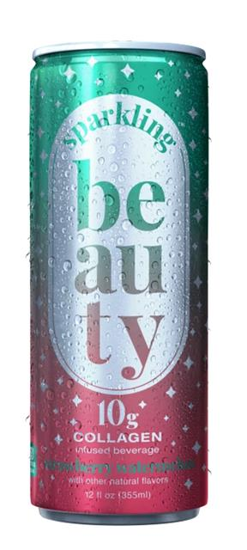
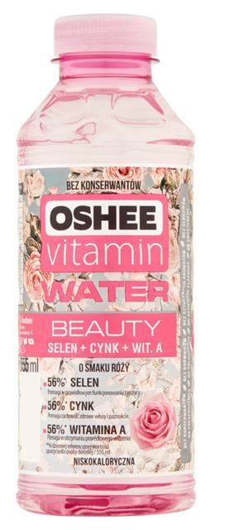
BEAUTY FROM INSIDE
Several new launches are positioning themselves around BEAUTY. The appeal for ELEGANCE is also evident in PACKAGING DESIGN.
SANT'ANNA BEAUTY
Italy – 10/2019
Flavoured water enriched with collagen (2g) and zinc for elasticity of the skin, reduction in wrinkles, brittle nails and joint mobility.
Natural flavours.
PEACH & BLACK PEPPER
BODY & FUTURE VITAMIN WATER
Slovakia – 06/2019
Vitamin water with collagen, no added sugar or preservatives. Enriched with vitamins.
LIME, MATE & JASMINE
QWELL COLLAGEN WATER
Bulgaria – 09/2019
Water enriched with collagen for beauty. Enriched with vitamin B7, B12 and zinc.
WHITE PEACH
SPARKLING BEAUTY
Germany – 12/2019
Sparkling water with 10g of collagen peptides for beauty. For skin, hair and nails. Natural flavours.
STRAWBERRY & WATERMELON
OSHEE VITAMIN WATER BEAUTY
Poland – 03/2020
Water for beauty enriched with selenium, zinc and vitamin A. Natural flavours.
ROSE or LAVENDER
www.expressions-aromatiques.com
Source : XTC Innovations
Notes:
Body & Future → vitamins C, B6, B12, niacin, pantothenic acid and folic acid.

Slide 15
HEMP / CBD
Certain KEY INGREDIENTS such as hemp or Cannabidiol are entering into the MAINSTREAM MARKET of functional foods and beverages.
SWEET REASON
Canada – 01/2019
Sparkling flavoured water enriched with cannabidiol. Natural flavours.
STRAWBERRY & LAVENDER
BAGA
France – 01/2020
Still beverage with plant extracts (verbena, lemon balm and chamomile) and cannabidiol.
APPLE & KIWI
THREE DOTS
United-Kingdom – 02/2020
Sparkling water with ashwagandha, ginseng and lemon balm, infused with cannabidiol (15mg). Natural flavours.
PEACH & ROOIBOS
JAMU ORGANIC SPICES
Germany – 02/2020
Organic beverage with cannabis, ginger and turmeric. No added sugar.
GINGER & TURMERIC
www.expressions-aromatiques.com
Source : XTC Innovations

Slide 16
HEMP / CBD
ALKALINE88
United-States – 01/2019
Sparkling hemp-infused water enriched with Himalayan minerals.
RASPBERRY
WELLER
United-States – 04/2019
Flavoured sparkling water infused with cannabidiol. Calorie free. THC free. Natural flavours.
BLACK CHERRY
ENDO HEMP WATER
United-States – 08/2019
Natural water infused with hemp oil for hydration. 10mg of hemp extract per 500ml bottle. No added sugar. No THC.
WATERMELON
MAD TASTY
United-States – 12/2019
Sparkling water with hemp extract in a modern can. Natural flavours.
WATERMELON & KIWI
www.expressions-aromatiques.com
Source : XTC Innovations

Slide 17
STILL FRUIT JUICE WATER
Riding the ALL-NATURAL wave, new HYBRID BEVERAGES are developing, blurring the boundaries between soft drinks and flavoured waters.
CRISTALINE
France – 03/2019
Spring water with grapefruit juice concentrate and no preservatives. Natural grapefruit flavour.
GRAPEFRUIT
VOLVIC JUICY BIO
France – 06/2019
Mineral water with organic fruit juice low in sugar. 50% less sugar than the average of sweetened flavoured drinks. Natural flavours.
APPLE
RIBENA FRUSION
United-Kingdom – 07/2019
Blackcurrant water infused with kiwi. Low calorie, no sweeteners and rich in vitamin C. Natural flavours.
BLACKCURRANT & KIWI
SPA DUO
Belgium – 08/2019
Flavoured beverage with mineral water, fruit juice and natural flavours. Low calorie.
LEMON & CUCUMBER
OASIS O'VERGER (Orangina Suntory)
France – 01/2020
Natural drink with spring water and fruits. No added sugar. Contains 40% fruits. Natural flavours.
APPLE, PINEAPPLE & PASSION FRUIT
www.expressions-aromatiques.com
Source : XTC Innovations

Slide 18
SPARKLING FRUIT JUICE WATER
Another example of hybrid beverages is SPARKLING FRUIT JUICE WATER, offering a HEALTHIER ALTERNATIVE to regular carbonated soft drinks.
PERRIER & JUICE (Nestle waters)
France – 03/2019
Low calorie drink with sparkling water and fruit juice. Natural flavour.
LEMON & GUAVA
CAWSTON DRY
United-Kingdom – 03/2019
Low calorie sparkling water with cold-pressed fruit juice. No added sugar or artificial sweeteners.
10kcal per can.
RASPBERRY
BADOIT
France – 07/2019
Sparkling mineral water with fruit juice and natural flavours. No colours or preservatives. 40% less sugar than sweetened flavoured drinks.
PINEAPPLE & LIME
COOP IRRESISTIBLE
United-Kingdom – 10/2019
Sparkling spring water with British rhubarb juice (10%) and flavours.
RHUBARB & GINGER
CRISTALINE
France – 04/2020
Carbonated spring water with fruit juice. Made in France.
ORANGE & LIME
www.expressions-aromatiques.com
Source : XTC Innovations

Slide 19
TEA INFUSED WATER
TEA as an ingredient has been gaining momentum as it fits perfectly in the global NATURAL and BETTER-FOR-YOU trend.
CONTREX (Nestle Waters)
France– 01/2019
Mineral water infused with organic mate. No sweeteners, preservatives or colours.
Natural Lemon Lime flavour.
MATE, LEMON & LIME
SANPELLEGRINO
Italy – 01/2019
Organic sparkling drink with tea extract and fruit juice. In a can with safety seal. Natural flavours.
PEACH & TEA
VOLVIC INFUSION BIO
France – 05/2019
Organic infused water with a dash of tea inspired by famous volcanoes. Low calorie. Natural flavours.
MOUNT FUJI - Raspberry & Cherry blossom with a dash of Matcha
CONTREX (Nestle Waters)
France– 04/2020
Mineral water infused with organic tea, low sugar content.
Natural flavours.
BLACK TEA & PEACH
GREEN TEA & LEMON
BADOIT BULLES & THE (Evian)
France – 06/2019
Green tea infused sparkling water. Low calorie and natural flavours.
GREEN TEA & MINT
www.expressions-aromatiques.com
Source : XTC Innovations

Slide 20
WHAT’S NEXT
New interesting launches include HOP WATER as an alternative to beer. Those products contain NO ALCOHOL, NO SUGAR and NO CALORIE but they taste just like beer.
LAGUNITAS HI-FI HOPS
United-States (California) – 01/2019
Cannabis infused sparkling beverage with hops. Contains 10mg THC. Alcohol and calorie free. Calming, refreshing and mood balancing.
HOP
WELLRAISER
United-Kingdom – 09/2019
Natural sparkling water infused with hops. No calories, sugar or sweeteners. Natural flavour.
HOP
INDIANA CITY BREWING CO.
United-States – 02/2020
Sparkling hop water in sophisticated can. No alcohol, sugar or calories. With citrusy American hops.
HOP
www.expressions-aromatiques.com
Source : XTC Innovations

